Slide 1
Data Visualization
Zack Dai

Slide 2
Why Charts?
It is a story

Slide 3
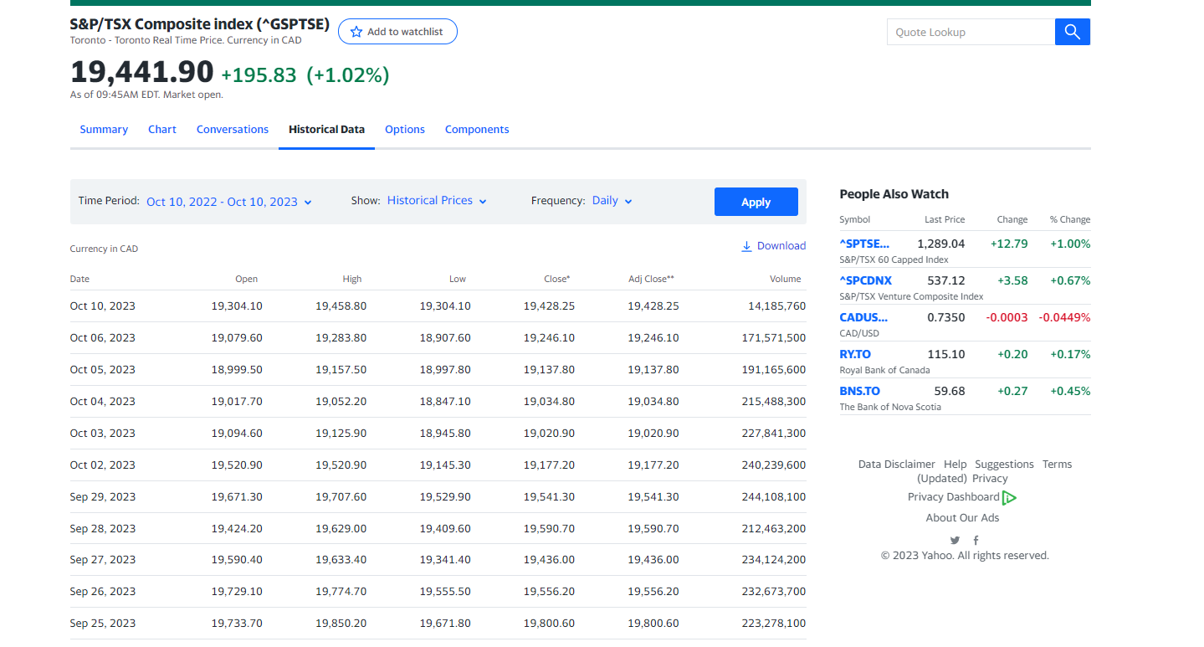
Consider this dataset
What do you see here?
https://ca.finance.yahoo.com/quote/%5EGSPTSE/history?p=%5EGSPTSE

Slide 4
Visualization with Excel
With the chart it is easy to find:
Trend
Pattern
Special Event
Correlations
STORY

Slide 5
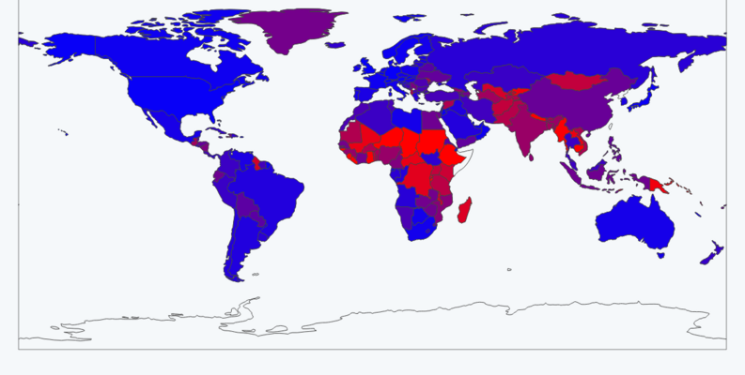
Pivot Table & Pivot Chart
https://www.kaggle.com/datasets/yusufglcan/country-data

Slide 6
Visualization with Python
Repeatable, at large scale, fast, in production

Slide 7

Libraries

Slide 8
Pandas and Colab
from faker import Faker
import pandas as pd
fk = Faker()
data = [fk.profile() for _ in range(100)]
df = pd.DataFrame(data)
df.head()

Slide 9
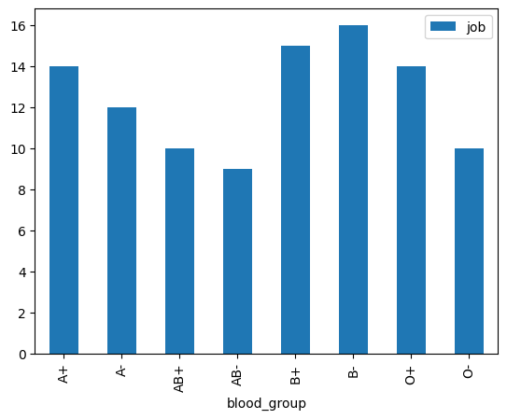
Aggregate and plot
blood_group = df.groupby('blood_group')['job'].count().reset_index()
blood_group
blood_group.plot.bar(x='blood_group', y='job')

Slide 10
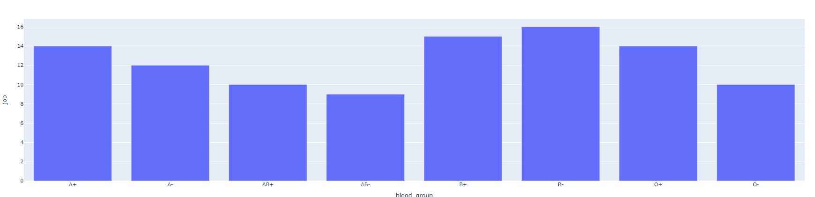
Interactive chart with Plotly
As pandas backend
pd.set_option('plotting.backend','plotly')
blood_group.plot.bar(x='blood_group', y='job’)
Plotly origin
from plotly import express as px fig = px.bar(blood_group, x='blood_group', y='job')
fig.show()

Slide 11
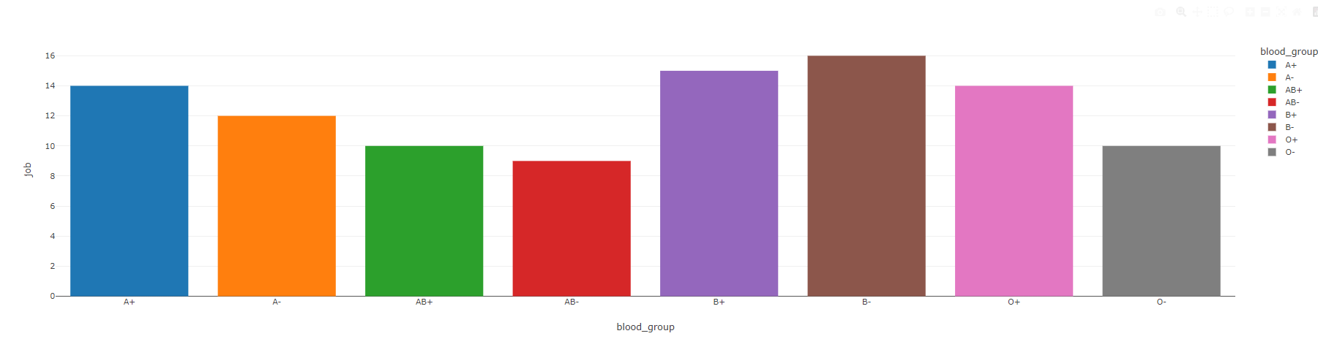
Plotly themes
https://plotly.com/python/templates/
Set Temporarily
fig = px.bar(blood_group, x='blood_group', y='job', template='none’)
Set Permenately
from plotly import io as pio
pio.templates.default = 'none’
Color sets
color_discrete_sequence=px.colors.sequential.RdBu
https://plotly.com/python/builtin-colorscales/

Slide 12
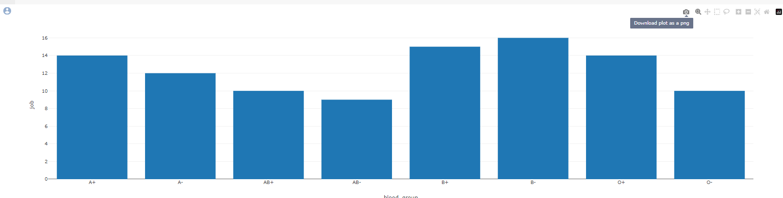
Chart interaction and save to file
fig.write_html('blood_group.html')

Slide 13
Chart types
Your story decide which to pick

Slide 14
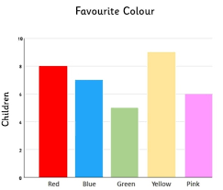
Bar chart
When to Use Bar Charts
Comparing Categories: Use bar charts when you want to compare different categories or groups of data against each other.
Displaying Discrete Data: They are effective for displaying discrete or categorical data.
Visualizing Trends: Helpful for visualizing trends, patterns, or changes over a period of time or across different categories.
Pros of Bar Charts
Clarity: Provide a clear and straightforward way to represent data, making it easy for the audience to understand and interpret.
Easy to Interpret: Intuitive and require minimal effort to interpret, even for individuals with limited data literacy.
Accurate Comparison: Facilitate accurate comparison of data points, especially when dealing with multiple categories.
Suitable for Large Data Sets: Can effectively handle large amounts of data without becoming cluttered or confusing.
Cons of Bar Charts
Limited for Continuous Data: Not suitable for representing continuous data or data with a large number of categories.
Less Effective for Trends: May not be the best choice for displaying trends over time compared to other chart types like line graphs.
Less Aesthetic Flexibility: Limited in terms of design and customization options compared to some other chart types.
Potential for Misrepresentation: Depending on scale and labeling, bar charts can be used to manipulate perceptions of data.

Slide 15
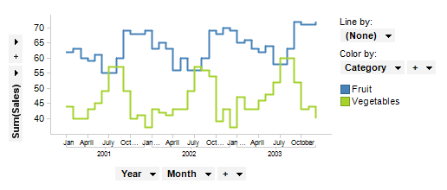
Line charts
When to Use Line Charts
Visualizing Trends: Utilize line charts to display trends or patterns over a continuous interval, such as time.
Showing Relationships: Effective for illustrating relationships or correlations between variables.
Highlighting Change Over Time: Ideal for emphasizing changes and fluctuations in data points across a defined period.
Pros of Line Charts
Highlight Trends: Exceptional at highlighting trends and patterns in data, providing a clear visual representation.
Effective for Time Series Data: Particularly useful for displaying data points that are collected sequentially over time.
Emphasis on Continuity: Emphasize the continuous nature of data, aiding in the understanding of gradual changes.
Facilitates Forecasting: Helps in making predictions or forecasting based on historical data trends.
Cons of Line Charts
Not Ideal for Categorical Data: Less effective when dealing with categorical or discrete data sets.
Less Suitable for Comparisons: May not be the best choice when comparing individual data points across different categories.
Complex for Large Datasets: Handling large datasets with numerous data points can lead to a cluttered and hard-to-interpret chart.
Misleading Without Context: Without proper labeling and scaling, line charts can potentially misrepresent data trends.

Slide 16
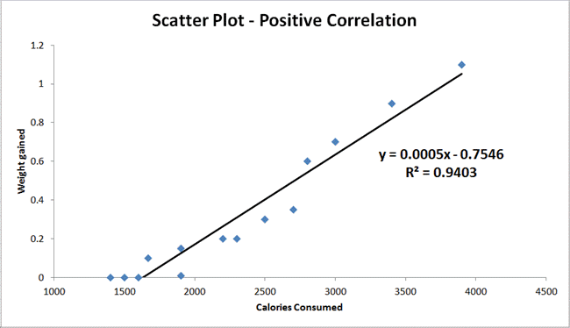
Scatter plot
When to Use Scatter Charts
Visualizing Relationships: Utilize scatter charts to examine relationships or correlations between two continuous variables.
Identifying Outliers: Effective for identifying outliers or unusual data points within a dataset.
Displaying Clusters or Patterns: Ideal for showcasing clusters, patterns, or groupings in data.
Pros of Scatter Charts
Visualizing Relationships: Excellent at revealing the strength and direction of relationships between variables.
Spotting Outliers: Provides a clear visual indication of outliers or data points that deviate from the norm.
Useful for Predictive Modeling: Essential in regression analysis and building predictive models.
Effective for Small Data Sets: Particularly useful when dealing with smaller datasets with limited data points.
Cons of Scatter Charts
Not Suitable for Categorical Data: Less effective when dealing with categorical or discrete data sets.
Limited in Data Representation: Can only represent two variables at a time, which may not be sufficient for complex data analysis.
Requires Context: Interpretation may be challenging without proper context or additional supporting information.
Potential for Overplotting: With a high density of data points, the chart can become cluttered and harder to interpret.
px.scatter(df_iris, x='sepal_width', y='sepal_length', color='species', size='sepal_length', trendline='ols')

Slide 17
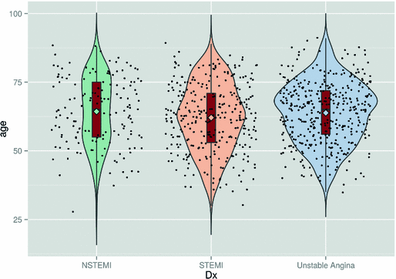
Violin and Box Plot
Violin Plot
Pros:
Displays Distribution: Provides a visual representation of the data's probability distribution, offering insights into its shape and spread.
Shows Density: Indicates data density at different values, aiding in identifying modes and clusters within the data.
Suitable for Small Datasets: Especially effective for smaller datasets where individual data points need emphasis.
Combines Box Plot and Kernel Density Plot: Offers a hybrid view of both summary statistics (box plot) and detailed distribution (kernel density plot).
Cons:
Complex Interpretation: May be more complex to interpret for individuals unfamiliar with the plot type.
Space-Intensive: Takes up more space compared to traditional box plots, potentially making visuals crowded in presentations.
Box Plot (Box-and-Whisker Plot)
Pros:
Summarizes Data Distribution: Offers a concise summary of the data distribution, highlighting central tendency, spread, and potential outliers.
Effective for Large Datasets: Well-suited for handling large datasets without overwhelming the viewer.
Robust to Outliers: Outliers are clearly marked, helping to identify potential anomalies in the data.
Cons:
Lack of Density Information: Does not provide insights into the underlying density or distribution shape.
Limited Detail: Less detailed compared to other plots like histograms or violin plots, especially for smaller datasets.
px.violin(df_iris, y='sepal_width', color='species', points='all', box=True)

Slide 18
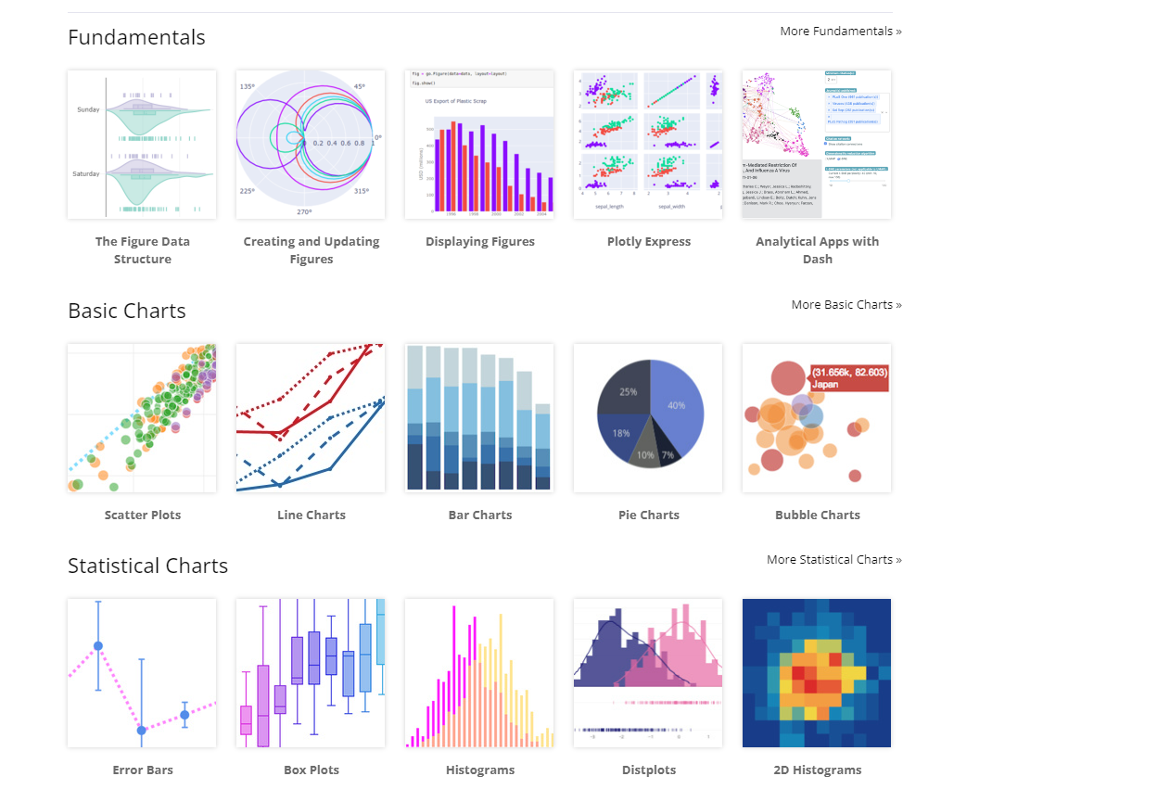
Other types of charts
https://plotly.com/python/

Slide 19
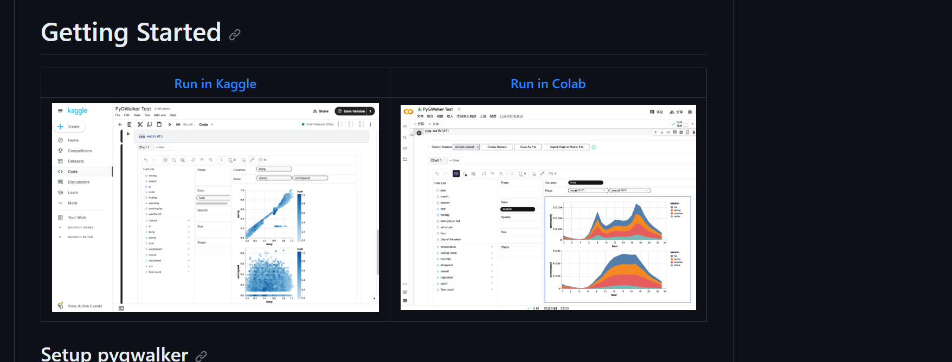
Low code visualization
https://github.com/Kanaries/pygwalker
Example: https://colab.research.google.com/drive/1jLve72KRFT-B6x8C3Z-wqtV5NSCV3klF#scrollTo=cjo4noUQbRKP

Slide 20
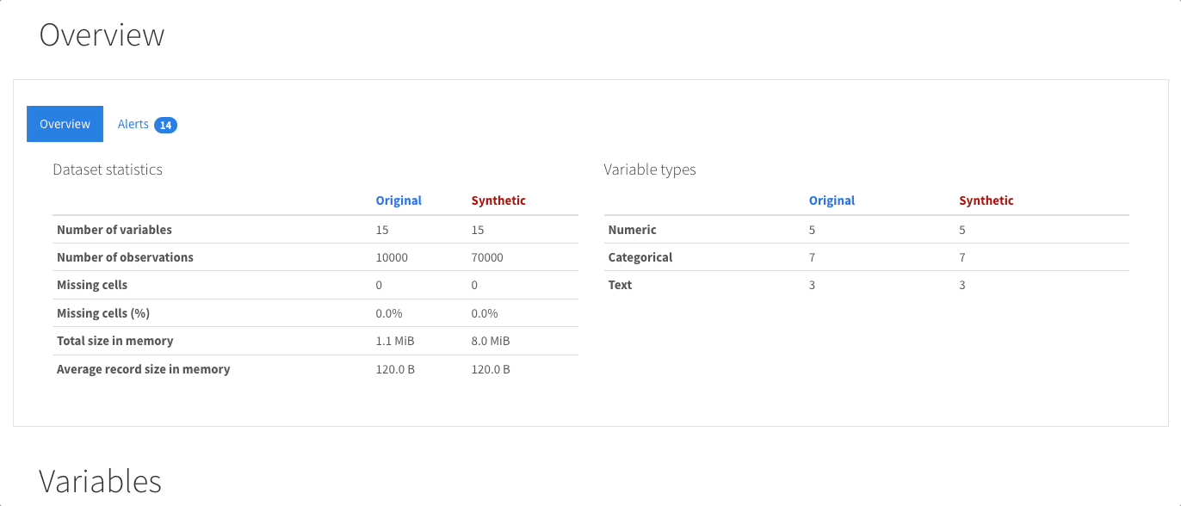
Auto Data Frame analyzer
https://docs.profiling.ydata.ai/4.6/

